Slide 1
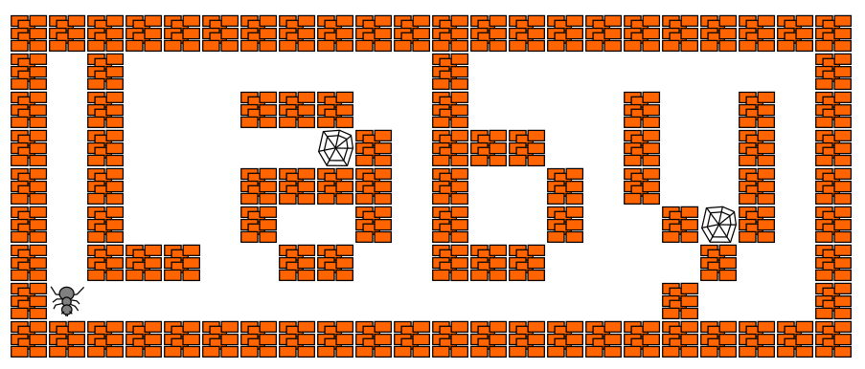
Laby using Python
Hamilton Python Users Group
Ian Stewart
18 May 2020

Slide 2
Laby using Python
Laby is a GUI application to learn how to program with ants and spider webs. You have to move an ant out of a labyrinth, while avoiding spider webs and moving rocks in your path.
Using Laby, you can learn: OCaml, C, C++, Java, Prolog, Ruby, Pascal, JavaScript, Python, Lua, Vala and Scheme.
Installation on Linux / Debian platform:
$ sudo apt install laby

Slide 3
Laby using Python
Initial Development: 2007
Current Version: V0.6.4-2. July 2017
Github site: https://github.com/sgimenez/laby
Website: https://sgimenez.github.io/laby/
Key Author: Stéphane Gimenez – and mostly French folks
Linux install: /usr/share/laby/
Linux Executable: /usr/games/laby
Labyrinths in: /usr/share/laby/levels
Written in: OCaml
Python: /usr/share/laby/mods/python/
Robot module: /usr/share/laby/mods/python/lib/robot.py
Executing scripts: /tmp/ant-nnnnn-n/ program.py robot.py

Slide 4
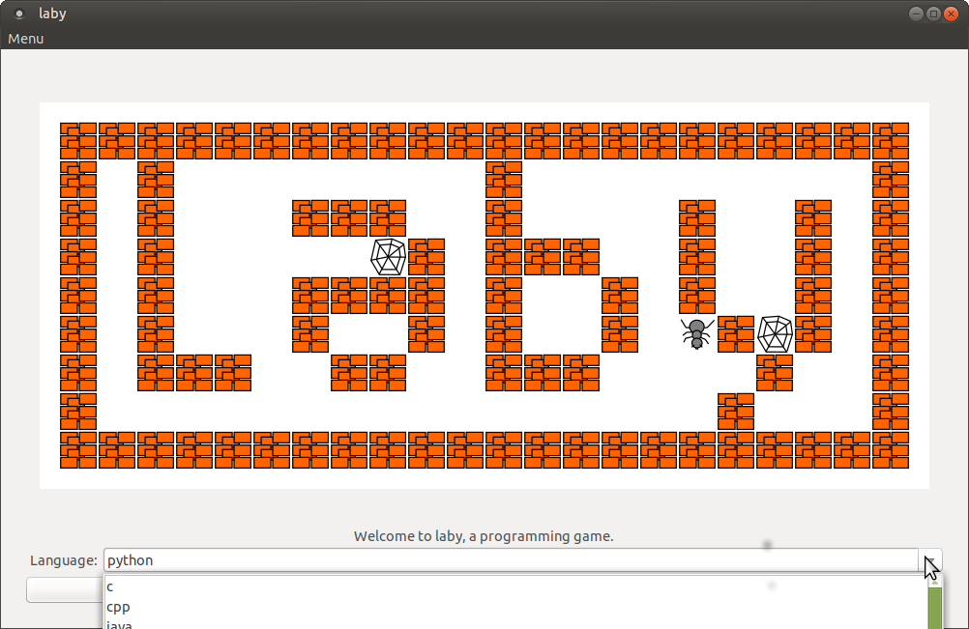
Laby using Python - Launching
Home Screen.
On Drop down menu.
Select Python as the Language

Slide 5
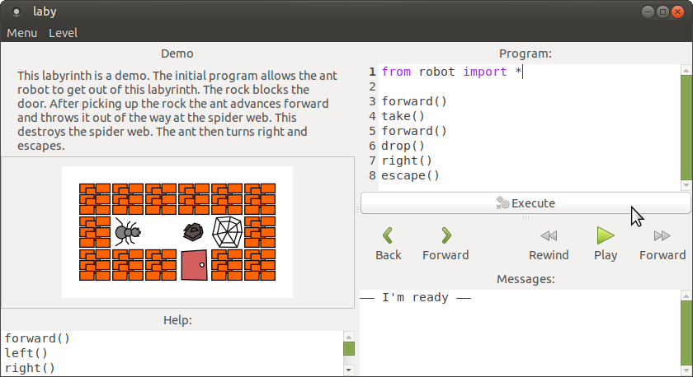
Laby using Python: Main Window
Select labyrinth. 13 supplied
Python executing functions in the robot module
Copy to /tmp/ Check syntax “I’m ready”
The labyrinth challenge
Run program at normal speed
Programming suggestions
Messages.
Ant: I can't go through the wall.
Python: TypeError: cannot concatenate

Slide 6
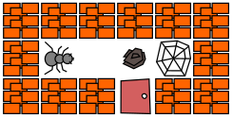
Laby using Python – Conceptual Diagram
/* My Program in C
# Escape from 0.laby
forward()
take()
forward()
drop()
forward()
right()
escape()
o o o o o o
o → . r w o
o o o x o o
C compiler
Laby
Files
Map:
# My Program in Perl
# Escape from 0.laby
forward()
take()
forward()
drop()
forward()
right()
escape()
Perl
# My Program in Python
from robot import *
forward()
take()
forward()
drop()
right()
escape()
Python Interpreter
stdout
Laby
Main Program
Ocaml language
stdout
stdout
stdin
stdin
stdin
Gtk
Graphics Display
robot module for C
robot module for Perl
# robot.py module for Python
import sys
# sys.stdin and sys.stdout

Slide 7
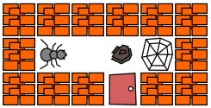
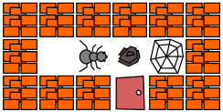
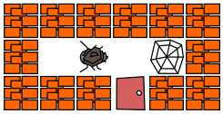
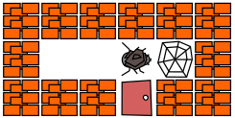
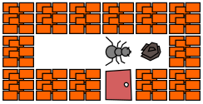
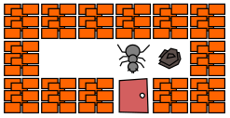
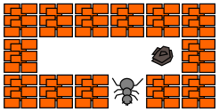
Laby. Steps in execution of program
From laby file create initial graphic
# My Program in Python
from robot import *
forward()
take()
forward()
drop()
right()
escape()
o o o o o o
o → . r w o
o o o x o o
Laby
Files
Map:
1. forward()
2. take()
3. forward()
4. drop()
5. right()
6. escape()

Slide 8
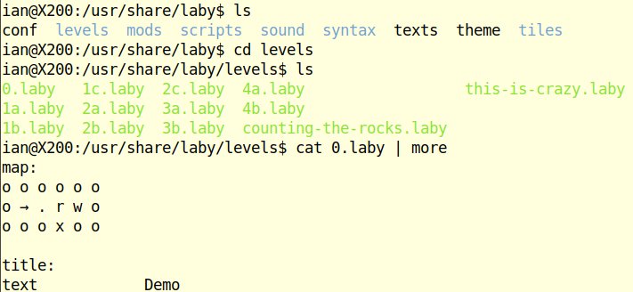
Laby. .laby files and the map:
o o o o o o
o → . r w o
o o o x o o
Laby
Files
Map:
To edit and create your own labyrinths its easier if only User priv is required:
$ sudo chmod 777 /usr/share/laby/levels

Slide 9
Laby. Rules
1/1
Ant can only move forwards one square at a time.
Ant can only determine what is in the one square in front of it.
Ant can only turn at 90 degree increments left or right.
Ant can carry one rock at a time.
Ant can not fit out the exit door carrying a rock.
If the Ant goes into a spiders web the ant is captured. No escape.
If an Ant drops a rock in a spiders web the web is destroyed.
A rock in front of an ant blocks it from going forward.
Rules with Random Rocks and Webs:
Rocks and Webs may be random in where they appear.
Ant can walk over broken rocks and small spider webs.

Slide 10
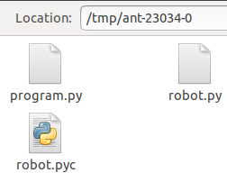
Laby. “Execute”
1/1
On clicking “Execute”:
Code in your program window is written to your temporary ant folder as the file “program.py”
Also “robot.py” is copied from /usr/share/laby/mods/python/lib/ to your temporary ant folder.
Plus the robot.py code is also compiled into byte code and stored as the file robot.pyc.

Slide 11
Laby using Python ~ Location of robot.py
1/4
robot.py is in: /usr/share/laby/mods/python/lib/
A unique ant folder is created in /tmp/ant-nnnnn-n.
E.g. /tmp/ant-5260-0/
$ ls /tmp/ant-5260-0/
program.py robot.py robot.pyc
The code in the Program window gets written to program.py in /tmp/ant/-nnnnn-n on clicking execute.
robot.py module is “copied” to /tmp/ant-nnnnn-n/. Thus robot.py in the python path of program.py.

Slide 12
Laby using Python ~ Location of robot.py
1/4
robot.py is in: /usr/share/laby/mods/python/lib/
A unique ant folder is created in /tmp/ant-nnnnn-n.
E.g. /tmp/ant-5260-0/
$ ls /tmp/ant-5260-0/
program.py robot.py robot.pyc
The code in the Program window gets written to program.py in /tmp/ant/-nnnnn-n on clicking execute.
robot.py module is “copied” to /tmp/ant-nnnnn-n/. Thus robot.py in the python path of program.py.

Slide 13
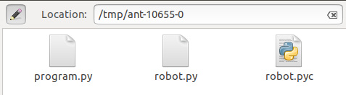
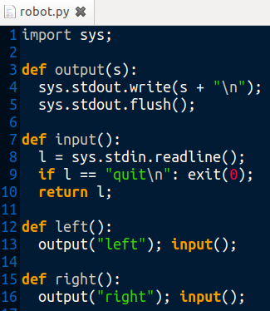
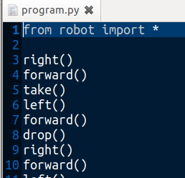
Laby. Program and Robot module placed in /tmp/ant-n
2/4

Slide 14
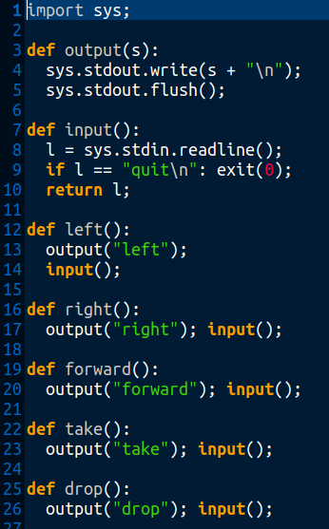
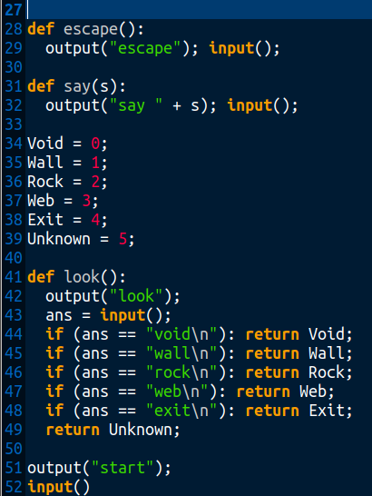
Laby. robot.py
3
/
4
76 x PEP8
recommendations.
Plus using input() which is a built-in function.

Slide 15
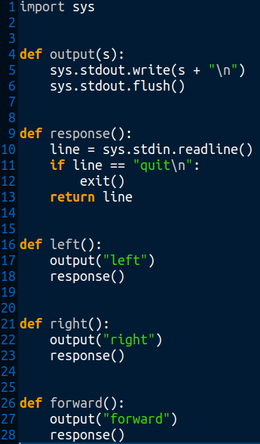
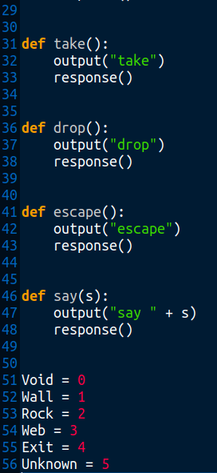
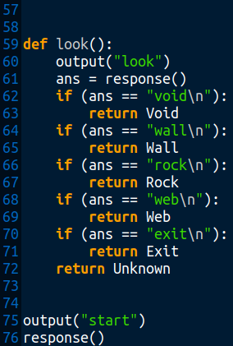
Laby
4/4
Changed input() to response() - used for look().
Otherwise response()
may be just to prevent
race
conditions?
robot.py
PEP8 compliant

Slide 16
Laby. Summary of 8 x robot.py functions:
1/1
Move: forward()
Turn: left(), right()
Rocks: take(), drop()
Exit Door: escape()
Messages: say(string)
What’s in front?: look()
Possible return strings: void, wall, exit, rock, web, unknown

Slide 17
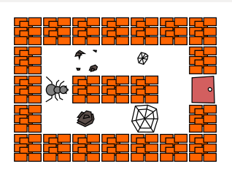
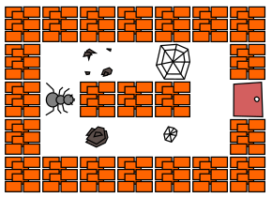
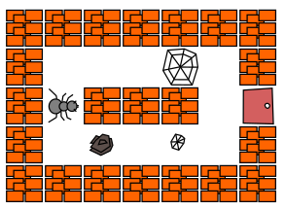
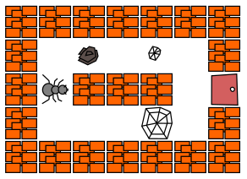
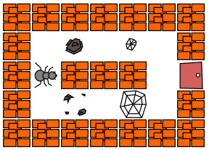
Laby. Random Rock and Web using “R” and “W”
1/1
map:
o o o o o o o
o . R . W . o
o → o o o . x
o . R . W . o
o o o o o o o

Slide 18
Laby. Ant direction?:
1/1
Internally the program knows the direction of the ant at all times. Four icons are used to display the ants four possible directions it can face, north, east, south and west.
There is not a robot module function to retrieve the current direction that the ant is facing.
A programming approach is to manually assign the direction the ant is facing at the start. E.g. “North”. All turns that are made are tracked relative to this initial direction.

Slide 19
Laby. Example Python conditional code:
1/5
for i in range(5):
forward()
if look() == Void:
forward()
while look() == Void:
forward()
integer = look():
Ocaml returns: void wall rock web exit
Python code returns: integer 0 to 5
Variables assigned to integers: Void, Wall, Rock, Web, Exit, Unknown

Slide 20
Laby. Example code: Rock removal
2/5
# Get a rock out of the way to go past
if look() == Rock:
take()
left()
left()
drop()
right(), right(), forward()
Comma separated function calls?
Works OK. Is it PEP8?

Slide 21
Laby. Example code: Go straight function
3/5
def go_straight():
while look() == Void:
forward()
go_straight()

Slide 22
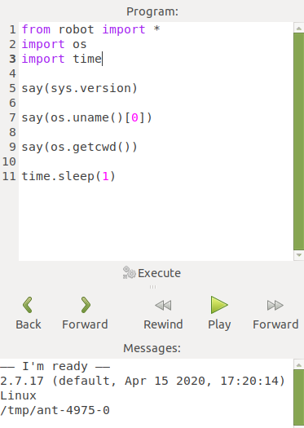
Laby. Example code: General Python
4/5
Remove semicolon
from robot import *
import os
import time
say(sys.version)
say(os.uname()[0])
say(os.getcwd())
time.sleep(1)
2.7.17 (default, Apr 15 2020, 17:20:14)
Linux
/tmp/ant-4975-0
sys imported by robot
say() can only say strings.
Avoid race condition
Python version 2

Slide 23
Laby. Example code: General Python
Laby. Example code
5/5
from robot import *
import os
import time
say(sys.version)
say(os.uname()[0])
say(os.getcwd())
say(os.path.expanduser("~"))
say(os.sep)
say(time.ctime())
time.sleep(1)
sys.exit("Exiting...")
—— I'm ready ——
2.7.17 (default, Apr 15 2020, 17:20:14)
Linux
/tmp/ant-4975-1
/home/ian
/
Tue May 12 10:04:10 2020
Exiting...

Slide 24
Laby: Ant GPS and Ant Logging system
1/10
home_path = os.path.expanduser("~")
dir_name = "laby_data"
file_name = "gps_data"
full_path = home_path + os.sep + dir_name
full_path_file = full_path + os.sep + file_name
# Create a laby_data dir off ~/ folder
if not os.path.exists(full_path):
os.makedirs(full_path)
# If ~/ not given, then folder created in cwd:
# /tmp/ant-4975-0/laby_data

Slide 25
Laby: Ant GPS and Ant Logging system
2/10
M1 = "Laby Global Positioning File. "
gps = [0, 0, 0] # Initial X, Y, coordinates & Direction
with open(full_path_file, "w") as fout:
fout.write(M1 + time.ctime() + "\n")
s = ""
for item in gps:
s = s + str(item) + ", "
fout.write(s[:-2] + "\n")
$ cat /home/ian/laby_data/gps_data
Laby Global Positioning File. Tue May 12 08:51:16 2020
0, 0, 0

Slide 26
Laby: Ant GPS and Ant Logging system
3/10
def gps_update(gps, action="forward"):
# Update the gps list file [x,y,d]
# Define constants for index into the gps list
X = 0
Y = 1
D = 2
# Direction Values: North, East, South and West
N = 0
E = 1
S = 2
W = 3
# Escape is one step forward
if action == "escape":
action = "forward"

Slide 27
Laby: Ant GPS and Ant Logging system
4/10
if action == "forward":
if gps[D] == N: # North
gps[Y] += 1
elif gps[D] == E: # East
gps[X] += 1
elif gps[D] == S: # South
gps[Y] -= 1
elif gps[D] == W: # West
gps[X] -= 1
elif action == "left":
gps[D] -= 1
if gps[D] == -1:
gps[D] = 3

Slide 28
Laby: Ant GPS and Ant Logging system
5/10
elif action == "right":
gps[D] += 1
if gps[D] == 4:
gps[D] = 0
# Log gps list to disk as comma seperated values
with open(full_path_file, "a") as fout:
s = ""
for item in gps:
s = s + str(item) + ", "
fout.write(s[:-2] + "\n")
return gps

Slide 29
Laby: Ant GPS and Ant Logging system
6/10
# Tracking option 1. - String
say("gps = [" + str(gps[0]) + ", "
+ str(gps[1]) +", "
+ str(gps[2]) + "]")
gps = [0, 1, 0]
# Tracking option 2. List comprehension. Slow output.
[say(str(i)) for i in gps]
0
1
0

Slide 30
Laby: Ant GPS and Ant Logging system
7/10
# Main program – Testing gps function
gps = [0, 0, 0]
gps = gps_update(gps,"forward")
gps = gps_update(gps,"right")
gps = gps_update(gps,"forward")
gps = gps_update(gps,"right")
gps = gps_update(gps,"forward")
gps = gps_update(gps,"right")
gps = gps_update(gps,"forward")
gps = gps_update(gps,"escape")

Slide 31
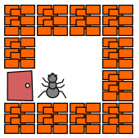
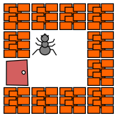
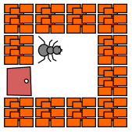
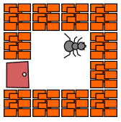
Laby: Ant GPS and Ant Logging system
8/10
# Main program
# with robot
# functions
gps = [0, 0, 0]
forward()
gps = gps_update(gps,"forward")
right()
gps = gps_update(gps,"right")
forward()
gps = gps_update(gps,"forward")

Slide 32
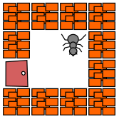
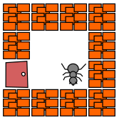
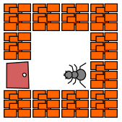
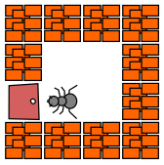
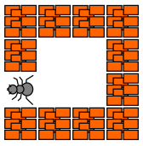
Laby: Ant GPS and Ant Logging system
9/10
right()
gps = gps_update(gps,"right")
forward()
gps = gps_update(gps,"forward")
right()
gps = gps_update(gps,"right")
forward()
gps = gps_update(gps,"forward")
escape()
gps = gps_update(gps,"escape")

Slide 33
Laby: Ant GPS and Ant Logging system
10/10
$ cat /home/ian/laby_data/gps_data
Laby Global Positioning File. Tue May 12 11:31:00 2020
0, 0, 0
0, 1, 0
0, 1, 1
1, 1, 1
1, 1, 2
1, 0, 2
1, 0, 3
0, 0, 3
-1, 0, 3
Ant last seen heading off into the sunset.
i.e. 3 = West

Slide 34
Laby. Backup of program.py 1/2
1/2
There is no backup of your program code so adding the following will perform a backup to a local folder.
import time
import shutil
# Backup python program.py to local folder
ts = time.strftime("%Y-%m-%d_%H-%M-%S",time.localtime())
home_path = os.path.expanduser("~")
dir_name = "laby_data"
file_name = "program_" + ts + ".py"
full_path = home_path + os.sep + dir_name
dest_path_file = full_path + os.sep + file_name

Slide 35
Laby. Backup of program.py
2/2
if not os.path.exists(full_path):
os.makedirs(full_path)
if os.path.isfile("program.py"):
say("Performing backup...")
shutil.copy2("program.py", dest_path_file)
say("Backup is: " + dest_path_file)
~$ cat laby_data/program_2020-05-12_18-36-14.py
from robot import *
import os
import time
import shutil

Slide 36
Laby. Mapping the Ant Universe
1/4
If we can track the coordinates and direction of the Ant, then we should be able to collect what the Ant can see and build a map of the Ant’s universe.
In the beginning we don’t know how big is the Ant’s universe and which way the ant is facing.
Assumptions:
Universe is less than 10 x 10
Ant starts off facing “north”.

Slide 37
Laby. Mapping the Ant Universe: Create Grid
2/4
def create_grid():
# Start with an empty grid - i.e. *
string = "*"
grid_max = 21
offset = 10
grid = [[string for i in range(grid_max)]
for j in range(grid_max)]
# Insert the starting point in the middle at 0,0
grid[0 + offset][0 + offset] = "s"
return grid
Grid updates follow X,Y convention:
grid[X][Y] = "s"

Slide 38
Laby. Write out the grid the simple way.
3/4
def write_grid(grid):
with open("/tmp/grid", "w") as fout:
count = -10
for item in grid:
s = ""
for sub_item in item:
s += sub_item + " "
fout.write("{}{: >3}\n".format(s, count))
count += 1
row_0 = "0-9-8-7-6-5-4-3-2-1 0 1 2 3 4 5 6 7 8 9 10\n"
fout.write(row_0)
row_1 = " Y-Axis"
fout.write(row_1)

Slide 39
Laby.
Default Grid.
Huh? 90 Degrees rotated from what is normal.
Should be turn one quadrant anticlockwise.
”s” for Start at 0,0.
4/4
* * * * * * * * * * * * * * * * * * * * * -10
* * * * * * * * * * * * * * * * * * * * * -9
* * * * * * * * * * * * * * * * * * * * * -8
* * * * * * * * * * * * * * * * * * * * * -7
* * * * * * * * * * * * * * * * * * * * * -6
* * * * * * * * * * * * * * * * * * * * * -5
* * * * * * * * * * * * * * * * * * * * * -4
* * * * * * * * * * * * * * * * * * * * * -3
* * * * * * * * * * * * * * * * * * * * * -2
* * * * * * * * * * * * * * * * * * * * * -1
* * * * * * * * * * s * * * * * * * * * * 0
* * * * * * * * * * * * * * * * * * * * * 1
* * * * * * * * * * * * * * * * * * * * * 2
* * * * * * * * * * * * * * * * * * * * * 3
* * * * * * * * * * * * * * * * * * * * * 4
* * * * * * * * * * * * * * * * * * * * * 5
* * * * * * * * * * * * * * * * * * * * * 6
* * * * * * * * * * * * * * * * * * * * * 7
* * * * * * * * * * * * * * * * * * * * * 8
* * * * * * * * * * * * * * * * * * * * * 9
* * * * * * * * * * * * * * * * * * * * * 10
0-9-8-7-6-5-4-3-2-1 0 1 2 3 4 5 6 7 8 9 10
Y-Axis
0,0
0,5
5,0
5,5

Slide 40
Laby. Write out the grid rotated to “normal”.
1/4
def rotate_grid(grid):
s = ""
count = offset
for k in range(grid_max):
grid_row_list = []
for i in reversed(range(grid_max)):
j = (grid_max - 1) - k
grid_row_list.append(grid[i][j])
# Reverse the temp row list
grid_row_list = list(reversed(grid_row_list))
for index in range(grid_max):
s += "{} ".format(grid_row_list[index])

Slide 41
Laby. Write out the grid rotated to “normal”.
2/4
# Build the Y Axis labelling
if k < 6:
s1 = y_axis_label[k]
else:
s1 = ""
s += "{: >3} {}\n".format(count, s1)
count -= 1
# Build the X Axis labelling
s += xaxis_label()
return s

Slide 42
Laby. Write out the grid rotated to “normal”.
3/4
def write_grid(grid_string):
with open("/tmp/grid", "w") as fout:
fout.write(grid_string)
grid = create_grid()
grid_string = rotate_grid(grid)
# Write rotated grid to grid file.
write_grid(grid_string)

Slide 43
Laby. Write out the grid rotated to “normal”.
Grid is now rotated to “normal” position.
4/4
* * * * * * * * * * * * * * * * * * * * * 10 Y
* * * * * * * * * * * * * * * * * * * * * 9
* * * * * * * * * * * * * * * * * * * * * 8 A
* * * * * * * * * * * * * * * * * * * * * 7 x
* * * * * * * * * * * * * * * * * * * * * 6 i
* * * * * * * * * * * * * * * * * * * * * 5 s
* * * * * * * * * * * * * * * * * * * * * 4
* * * * * * * * * * * * * * * * * * * * * 3
* * * * * * * * * * * * * * * * * * * * * 2
* * * * * * * * * * * * * * * * * * * * * 1
* * * * * * * * * * s * * * * * * * * * * 0
* * * * * * * * * * * * * * * * * * * * * -1
* * * * * * * * * * * * * * * * * * * * * -2
* * * * * * * * * * * * * * * * * * * * * -3
* * * * * * * * * * * * * * * * * * * * * -4
* * * * * * * * * * * * * * * * * * * * * -5
* * * * * * * * * * * * * * * * * * * * * -6
* * * * * * * * * * * * * * * * * * * * * -7
* * * * * * * * * * * * * * * * * * * * * -8
* * * * * * * * * * * * * * * * * * * * * -9
* * * * * * * * * * * * * * * * * * * * * -10
0 9 8 7 6 5 4 3 2 1 0 1 2 3 4 5 6 7 8 9 0
1 - - - - - - - - - 1
- X Axis
0,5
5,5
0,0
5,0

Slide 44
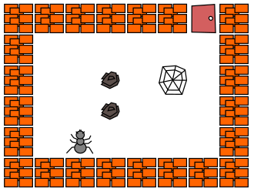
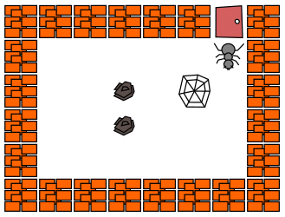
Laby. Ant Goes Exploring.
1/2
Starts here... ...explores... Stops here...

Slide 45
Laby. Explorers Map
Enlarged
2/2
* * * * * * * * * * * * * * * * * * * * * 10 Y
* * * * * * * * * * * * * * * * * * * * * 9
* * * * * * * * * * * * * * * * * * * * * 8 A
* * * * * * * * * * * * * * * * * * * * * 7 x
* * * * * * * * * * * * * * * * * * * * * 6 i
* * * * * * * * * * * * * * * * * * * * * 5 s
* * * * * * * * * o o o o o x * * * * * * 4
* * * * * * * * o . . . . . v o * * * * * 3
* * * * * * * * o . . r . w . o * * * * * 2
* * * * * * * * o . . r . . . o * * * * * 1
* * * * * * * * o . s . . . . o * * * * * 0
* * * * * * * * * o o o o o o * * * * * * -1
* * * * * * * * * * * * * * * * * * * * * -2
* * * * * * * * * * * * * * * * * * * * * -3
* * * * * * * * * * * * * * * * * * * * * -4
* * * * * * * * * * * * * * * * * * * * * -5
* * * * * * * * * * * * * * * * * * * * * -6
* * * * * * * * * * * * * * * * * * * * * -7
* * * * * * * * * * * * * * * * * * * * * -8
* * * * * * * * * * * * * * * * * * * * * -9
* * * * * * * * * * * * * * * * * * * * * -10
0 9 8 7 6 5 4 3 2 1 0 1 2 3 4 5 6 7 8 9 0
1 - - - - - - - - - 1
- X Axis
* * * * * * * * * *
* * o o o o o x * *
* o . . . . . v o *
* o . . r . w . o *
* o . . r . . . o *
* o . s . . . . o *
* * o o o o o o * *
* * * * * * * * * *
0,0
0,0

Slide 46
Laby. Explorers Map
Enlarged
2/2
* * * * * * * * * * * * * * * * * * * * * 10 Y
* * * * * * * * * * * * * * * * * * * * * 9
* * * * * * * * * * * * * * * * * * * * * 8 A
* * * * * * * * * * * * * * * * * * * * * 7 x
* * * * * * * * * * * * * * * * * * * * * 6 i
* * * * * * * * * * * * * * * * * * * * * 5 s
* * * * * * * * * o o o o o x * * * * * * 4
* * * * * * * * o . . . . . v o * * * * * 3
* * * * * * * * o . . r . w . o * * * * * 2
* * * * * * * * o . . r . . . o * * * * * 1
* * * * * * * * o . s . . . . o * * * * * 0
* * * * * * * * * o o o o o o * * * * * * -1
* * * * * * * * * * * * * * * * * * * * * -2
* * * * * * * * * * * * * * * * * * * * * -3
* * * * * * * * * * * * * * * * * * * * * -4
* * * * * * * * * * * * * * * * * * * * * -5
* * * * * * * * * * * * * * * * * * * * * -6
* * * * * * * * * * * * * * * * * * * * * -7
* * * * * * * * * * * * * * * * * * * * * -8
* * * * * * * * * * * * * * * * * * * * * -9
* * * * * * * * * * * * * * * * * * * * * -10
0 9 8 7 6 5 4 3 2 1 0 1 2 3 4 5 6 7 8 9 0
1 - - - - - - - - - 1
- X Axis
* * * * * * * * * *
* * o o o o o x * *
* o . . . . . v o *
* o . . r . w . o *
* o . . r . . . o *
* o . s . . . . o *
* * o o o o o o * *
* * * * * * * * * *
0,0
0,0

Slide 47
Laby. Version 0.6.4-2. Only Python2 support
1/8
Supported languages – If they are installed
:~$ ls /usr/share/laby/mods/
c cpp java js lua ocaml pascal
perl prolog python ruby scheme vala
say(sys.version)
2.7.17 (default, Apr 15 2020, 17:20:14)
Code run in Laby Program window when using python...

Slide 48
Laby. Add Python3 support
2/8
Copy the python tree to a new python3 tree...
:~$ sudo cp -R /usr/share/laby/mods/python/. \
/usr/share/laby/mods/python3
Python3 tree. Laby launch page has python3 option.
:~$ tree /usr/share/laby/mods/python3
/usr/share/laby/mods/python3
├── help
├── lib
│ └── robot.py
├── rules
└── skel
Maybe change so you don’t need sudo to edit the files
$ sudo chmod 777 -R /usr/share/laby/mods/python3
Files still need to be edited to provide Python 3

Slide 49
Laby. Version 3.64. Only Python2 support
3/8
Code: say(sys.version)
Message: 2.7.17 (default, Apr 15 2020, 17:20:14)
:/usr/share/laby/mods/python$ cat rules
info:
need python
run:
fetch robot.py
dump program.py
spawn python program.py

Slide 50
Laby. Edited “rules” file and restart. Now Python 3
4/8
:/usr/share/laby/mods/python3$ cat rules
info:
need python3
run:
fetch robot.py
dump program.py
spawn python3 program.py
Added “3”
Added “3”
Code: say(sys.version)
Message: 3.6.9 (default, Apr 18 2020, 01:56:04)

Slide 51
Laby. Edited “skel” file and remove semicolon
5/8
Line 1. With semicolon...
:~$ cat /usr/share/laby/mods/python3/skel
from robot import *;
:~$ cat /usr/share/laby/mods/python3/skel
from robot import *
With semicolon removed...
Removed “;”
This semicolon seemed to cause problems with adding other modules in the Laby Program window.

Slide 52
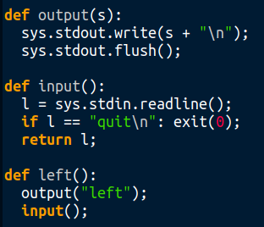
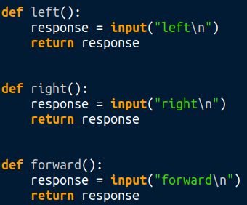
Laby. Re-Write robot.py for Python3:
6/8
Instead of sys.stdout.write(), sys.stdout.flush() and sys.stdin.readline(); use input() with prompt.

Slide 53
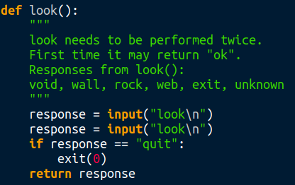
Laby. Re-Write robot.py for Python3:
7/8
look() function is simplified under Python 3 using input()

Slide 54
Laby. Replace robot.py code
8/8
In /usr/share/laby/mods/python3/lib/ is the robot.py module. Using Python3 this module imports OK and
appears to work reasonably well.
A replacement version of robot.py has been created. This is more PEP8 compliant and utilizes Python3 features.
Refer to: https://github.com/irsbugs/laby_python3

Slide 55
Laby. Summary of additional functions
Rather than have these functions take up space in the Program window, move additional functions to the robot.py module in /usr/share/laby/mods/python3/lib
1/2
Python 3 version check
Positioning with X, Y coordinates and Directions
Log ant movement to local CSV file storing X,Y,D.
Backup the program.py file to a local folder.
Drop a rock left / drop a rock right
Explore around each position
Create a grid map of the room

Slide 56
Laby. robot.py files:
2/2
Various flavours of robot.py are posted here:
https://github.com/irsbugs/laby_python3/tree/master/robot_files
Review the README.md at the above and select which file you want to become your robot.py.

Slide 57
Laby. Issues and Work-arounds:
1/1
May fail to execute the last command. Add to the program code, after the last command:
import time
time.sleep(1)
look() function may not return correct data on first attempt. Edit the robot.py file and in the look() function get it to execute the input() function twice:
response = input("look\n")
response = input("look\n")

Slide 58
Laby. Ant Official Intelligence:
1/1
The function ant_official_intelligence() is also included in robot.py. Using this function the ant will be able to travel through many maze designs and escape.
This function utilizes these additional functions: drop_rock(), and either check_right() or check_left()
Select your maze design, then in the Program window enter either:
ant_official_intelligence("right")
ant_official_intelligence("left")

Slide 59
Laby.
Review Github repository files https://github.com/irsbugs/laby_python3
Demo

Slide 60
Laby using Python ~ Questions / End
Other programming challenges:
Have two adjoining rooms with all the rocks randomly located in one room. Ant must move all rocks to the other room before exiting.
Have a big room with randomly placed rocks and webs. Ant has to effectively mow the lawns. Must move rocks out of the way to mow their square and must mow around spider webs.

